Slide 1
RED CELL MEMBRANE DISORDERS
Dr. Ali Khazaal Jumaa
F.I.B.M.S (Int. Medicine) , F.I.B.M.S (Hematology)

Slide 2
The red cell membrane
- RBC membrane plays a critical role in the maintenance of the biconcave shape and integrity of the red cell.
- It provides flexibility, durability, and tensile strength, enabling erythrocytes to undergo extensive and repeated distortion during their passage through the microvasculature.
- It consists of a lipid bilayer with embedded transmembrane proteins and an underlying membrane protein skeleton that is attached to the bilayer via linker proteins.
- The integrity of the membrane relies on vertical interactions between the skeleton and the bilayer, as well as on horizontal interactions within the membrane skeletal network.

Slide 3
HEREDITARY SPHEROCYTOSIS (HS)
. HS is typically inherited in an autosomal dominant fashion. However, In approximately 25% of cases, HS is autosomal recessive.
. Deficiency in spectrin, ankyrin, band 3, and protein 4.2
. Compromised vertical interactions between the membrane skeleton and the lipid bilayer.
. The membrane protein deficiency destabilizes the lipid bilayer, causing microvesicles to bud off from weakened areas, which leads to spherocyte formation.
. Spherocytes exhibit a decreased surface area-to-volume ratio and are dehydrated, which decreases their deformability.
. The passage of spherocytes through the spleen is impeded, and during erythrostasis they are engulfed by splenic macrophages and destroyed.

Slide 4
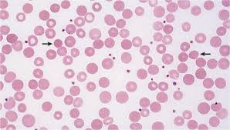

Slide 5
Clinical Features
. The typical clinical picture of HS combines evidence of hemolysis with spherocytosis and positive family history.
. The clinical manifestations of HS vary widely. Mild, moderate, and severe forms of HS have been defined according to differences in hemoglobin, bilirubin, and reticulocyte counts, which can be correlated with the degree of compensation for hemolysis.
. Approximately 20-30% of HS patients have mild disease with compensated hemolysis.
. As many as 10% of HS patients have severe disease in infancy. A small number of these, typically with autosomal recessive HS, present with life-threatening, transfusion- dependent anemia.
. Mild – moderate splenomegaly

Slide 6
Complications
. Bilirubin gallstones in approximately 50% of patients.
. Hemolytic crises are usually associated with viral illnesses and typically occur in childhood.
. Parvovirus B19 infection can precipitate an aplastic crisis with coexistent reticulocytopenia.
. Megaloblastic crises may occur in patients with increased folate demands such as during pregnancy.
. Severely affected individuals may develop iron overload.

Slide 7
Laboratory Features
. Spherocytes on the blood film are the hallmark of the disease and are characterized by a smaller diameter, darker staining, and a decreased or absent central pallor, compared to normal red cells
. Mild to moderate anemia
. Increased mean (red) cell hemoglobin concentration (MCHC) in approximately 50% of cases.
. Increased serum LDH and unconjugated bilirubin
. Increased urobilinogen in the urine.
. Osmotic fragility test
. Eosin 5′-maleimide test

Slide 8
Other causes of spherocytosis:
- Autoimmune hemolytic anemia
- Acute and delayed hemolytic transfusion reactions
- Pyruvate kinase deficiency
- Hypophosphatemia
- Snake bites
- Hyposplenism

Slide 9
Treatment
. Patients with aplastic crises or severe hemolysis may require transfusion.
. Splenectomy: for patients with severe disease
. Folic acid

Slide 10
HEREDITARY ELLIPTOCYTOSIS (OVALOCYTOSIS)
. Hereditary elliptocytosis (HE) is characterized by the presence of elliptical or oval erythrocytes
. It is typically inherited as an autosomal dominant disorder
. The primary abnormality is defective horizontal interactions between protein components of the membrane skeleton
. Spectrin and protein 4.1 deficiency

Slide 11
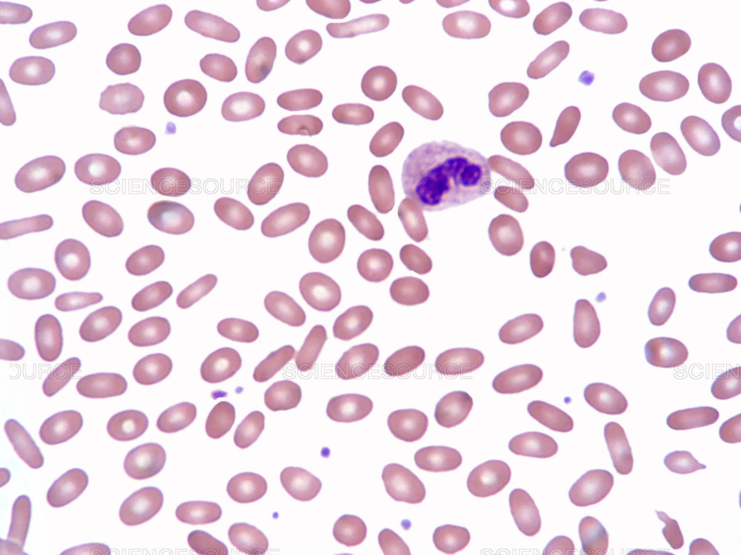

Slide 12
Clinical Features
. The majority of HE patients are asymptomatic.
. Occasionally, severe forms of HE require red cell transfusion
. Jaundice
. Bilirubin gallstones
. Splenomegaly

Slide 13
Investigations
. Blood film: ovalocytes
. Reticulocytosis
. LDH, Bilirubin
. membrane proteins by quantitative SDS-PAGE
Acquired elliptocytes are associated with several disorders, including megaloblastic anemia, iron-deficiency anemia and thalassemia, myelodysplastic syndromes, and myelofibrosis.

Slide 14
Treatment
. Folic acid
. RBC transfusion : in severe anemia
. Splenectomy : rarely needed

Slide 15
HEREDITARY PYROPOIKILOCYTOSIS
. It is a rare autosomal recessive disorder typically found in patients of African origin.
. HPP is characterized by severe hemolytic anemia with marked microspherocytes, and very few elliptocytes on the blood film.
. The mean red cell volume (MCV) is very low, ranging between 50 and 70 fL.
. HPP patients are often transfusion-dependent, and splenectomy is beneficial
. The molecular defects in HPP patients are a combination of horizontal and vertical abnormalities.

Slide 16
HEREDITARY STOMATOCYTOSIS SYNDROMES
. Stomatocytes are cup-shaped red cells characterized by a central hemoglobin-free area
. A net increase in cations causes water to enter the cells, resulting in overhydrated cells or stomatocytes, whereas a net loss of cations dehydrates the cells and forms xerocytes.
. Erythrocyte volume homeostasis is linked to monovalent cationic permeability, and this is disrupted in the hereditary stomatocytosis syndromes.
. These disorders are rare, and inherited in an autosomal dominant fashion with marked clinical and biochemical heterogeneity.

Slide 17
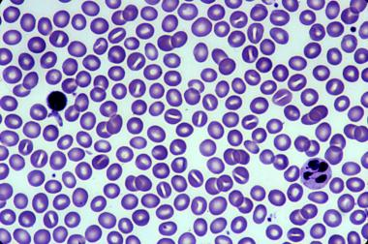
Hereditary Stomatocytosis/Hydrocytosis
. This autosomal dominant disease is characterized by moderate to severe hemolytic anemia.
. It is caused by a marked passive sodium leak into the cell.
Red cell indices show decreased MCHC and a highly elevated MCV up to 150 fL

Slide 18
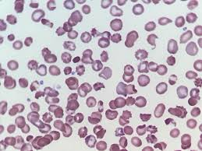
Hereditary Xerocytosis
This autosomal dominant disease is characterized by mild to moderate compensated hemolytic anemia.
There is an efflux of potassium and red cell dehydration.
The MCHC is increased

Slide 19
Treatment
. Folic acid
. RBC transfusion: in severe anemia
. Splenectomy should be avoided because of the risk of thrombosis, including hepatic and portal vein thrombosis. If splenectomy is necessary, lifelong anticoagulation should be introduced.

Slide 20
RBC Enzymopathies

Slide 21
RBC need a supply of energy in the form of ATP and a source of
reducing power in order to fulfil their function.
Mature RBC contain no DNA or RNA and hence are incapable of protein synthesis, and the only source of energy as ATP is derived from anaerobic glycolysis.
ATP is required to maintain the membrane in its deformable state, with asymmetric lipid layers, and to regulate ion and water exchange.
Reducing power is required to reduce methemoglobin to its functional state of deoxyhemoglobin and to counteract the strong oxidative stresses.

Slide 22
- The lack of protein synthesis in the mature red cell means that
none of the enzymes in the metabolic pathways can be replaced
during the red cell lifespan. Over the 120 days of normal red
cell survival, enzyme activities decline at variable but predictable
rates. This decline probably contributes to the ageing process
of the red cell.
Many of the abnormalities that affect red cell metabolism provoke
hemolytic anemia.

Slide 23
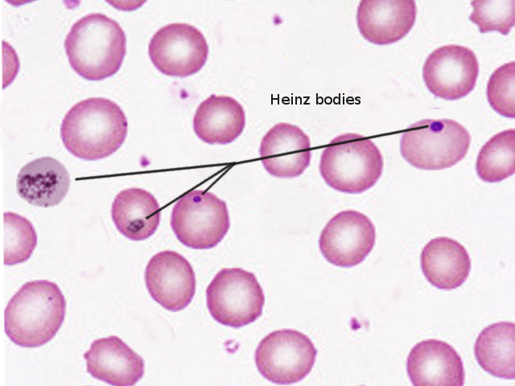
Mechanism of hemolysis
RBC membrane damage
oxidant challenge leads to the formation of denatured hemoglobin
(Heinz bodies), which make the red cells less deformable and liable
to splenic destruction.

Slide 24
1- Disorders of the glycolytic pathway
(Embden–Meyerhof pathway)
Pyruvate kinase deficiency
. Pyruvate kinase (PK) is one of the dominant controlling enzymes in glucose metabolism.
. It catalyses the final steps of the glycolytic pathway with the concomitant phosphorylation of ADP to ATP.
. PK deficiency is the most common enzymopathy of the glycolytic pathway inherited in an autosomal recessive form.

Slide 25
Clinical features
The presenting features may vary from severe neonatal jaundice and anemia, severe chronic non-spherocytic hemolytic anemia requiring repeated transfusions, moderate hemolysis with exacerbation during infections or pregnancy, to symptomless compensated hemolysis with only a minor apparent anemia.
. Pallor
. Jaundice
. Gallstones
. Splenomegaly

Slide 26
Laboratory findings
. Hemolytic anemia
. B. film : some spherocytes
. Low enzyme activity

Slide 27
Treatment
. RBC transfusion : for severe symptomatic anemia
. Folic acid
. Splenectomy : for transfusion- dependent cases

Slide 28
Other enzymopathies of the glycolytic system
Hexokinase deficiency
Glucose phosphate isomerase deficiency
Phosphofructokinase deficiency
Fructose diphosphate aldolase A deficiency
Triose phosphate isomerase deficiency
Phosphoglycerate kinase deficiency

Slide 29
2- disorders of Pentose phosphate pathway
(hexose monophosphate shunt)
- In RBC, its only function is the production of reducing power in the
form of NADPH (Reduced nicotinamide adenine dinucleotide phosphate).
- The first step of the pathway, catalysed by G6PD (Glucose-6-phosphate dehydrogenase).
- About 10% of glucose is metabolized by the pentose phosphate
pathway

Slide 30
Glucose-6-phosphate dehydrogenase (G6PD) deficiency
It is the most frequent defect of the pentose phosphate pathway
X-linked recessive . more common in males
. female are affected in homozygous pattern and
in heterozygous by the effects of X-
inactivation (lionization).
More than 180 different variants
It is widely disseminated throughout Africa, the Mediterranean basin,
the Middle East, Southeast Asia and India.

Slide 31
There are four main syndromes associated with G6PD
deficiency differing in their clinical presentations:
. Neonatal jaundice
. Favism
. Chronic non-spherocytic hemolytic anemia (CNSHA)
. Drug-induced hemolytic anemia.
In all four, hemolysis is aggravated or promoted by exposure to oxidative stress through infection or ingestion of oxidative foods or drugs.

Slide 32
Favism
- Favism is the term given to the G6PD syndrome where acute intravascular hemolysis may be precipitated by exposure fava beans, ingested in any form, usually about 24 hours after the exposure.
- The amount of hemolysis is dose-related, which may explain the marked variation in susceptibility not only in different subjects, but also in the same individual at different times.
- Other compounds may be blamed: henna, peas, lentils, or peanuts
- Between attacks of favism or exposure to oxidizing substances, the blood count is normal with no evidence of hemolysis.
- The co-occurrence of infection, which promotes the formation of hydrogen peroxide, may promote hemolysis.

Slide 33
Drug-induced acute hemolysis

Slide 34
Laboratory diagnosis
. Acute intravascular hemolysis raises the suspicion of G6PD deficiency.
. Hemoglobinuria may be gross, producing almost black urine.
. Quantitative assay of G6PD activity. Since G6PD activity is RBC age-dependent, the measurement of enzyme activity might yield false-normal results in the presence of reticulocytosis, (i.e. during hemolytic attack).
. DNA analysis is the most effective way of identifying heterozygotes.

Slide 35
Management
- education in the avoidance of oxidizing substances
- Acute intravascular hemolysis may require transfusion,
but the anemia is often self-limiting.
High fluid intake should be encouraged to prevent renal damage.
CNSHA may be severe enough to warrant active treatment and
splenectomy may be helpful.

